Slide 1
ADVANCED REACT
Recap on the important concepts in React

Slide 2
OBJECTIVES
In this module, you will
Be introduced to the new way of creating react apps
Consider key concepts including JSX, props and the component lifecycle
Create and render components
Discuss how to organize components for best practices such as component naming and separation of concerns
Create a logical hierarchy of components

Slide 3
Installing React

Slide 4
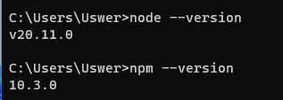
ReactJS is predictably built using node, although as you will see, there are many ways we can extend React from it’s base install.
Check that you have both node and npm installed. In a terminal or VSCode, type:
node --version
And then
npm --version
Built on Node
Notes:
npm = node packet manager and it is how we download and manage all packages that we can use in node.
Following the work done with javascript, this should be installed, but it is always good practice to check the version you are using and update if necessary

Slide 5
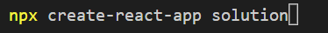

React is very easy to install in VSCode just a few short commands and you have an install that runs exactly as you would hope.
The command below allows us to create an app in a folder base:
npx create-react-app appname
The process may take a couple of minutes. There will be some standard warnings (these are being worked on by the creators – ignore them!!)
cd into the folder
npm start
Traditional method of
Installing React
Notes:
Do not get users to do this, this is an informational slide on how it was done recently.

Slide 6
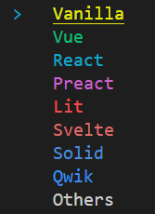
React is very easy to install in VSCode just a few short commands and you have an install that runs exactly as you would hope.
The command below allows us to create an app in a folder base:
npx create-vite@latest solution
The first time you run this, you will be asked to install a specific version of vite. You can respond with ‘y’.
You will be presented with a list of framework options. Use the arrow keys to select React
Installing React - vite
Notes:
npx is similar to npm, but calls the content from cdn rather than the installed version on npm. Solution is the name of the app you are creating.

Slide 7
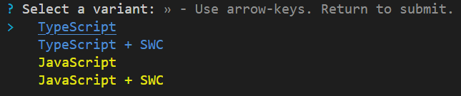
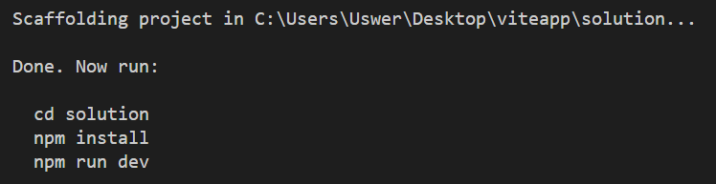
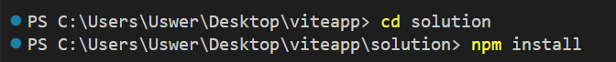
Select TypeScript using the arrow keys again to select the variant
With the structure now ready, we need to navigate to our new folder and perform an ‘npm install’.
Once complete, this will allow us to run ‘npm run dev’ to fire up the webpage
Installing React - vite

Slide 8
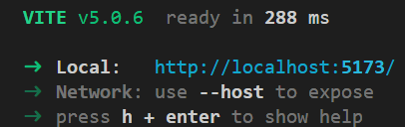
This will build a live server which allows us to see how our app looks in a browser
You can click on the link to open the browser
Installing React - vite

Slide 9
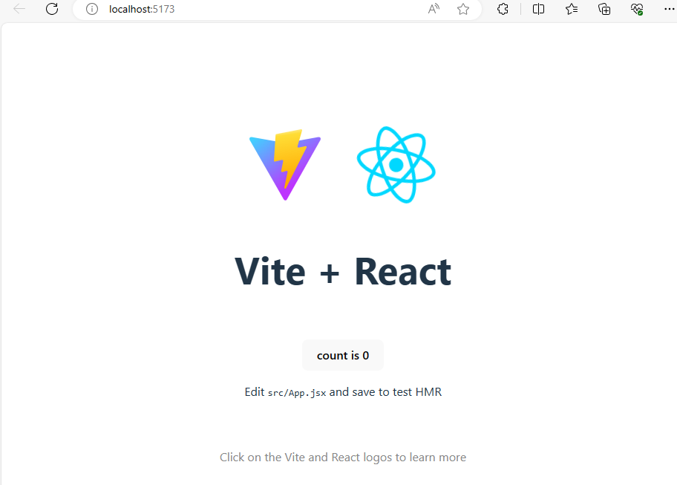
Gives you a live locally hosted webpage
You are now ready to explore the framework
Installing React

Slide 10
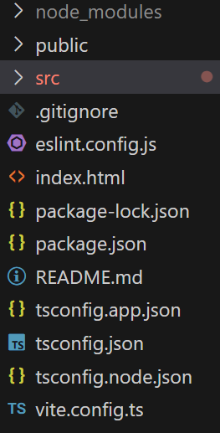
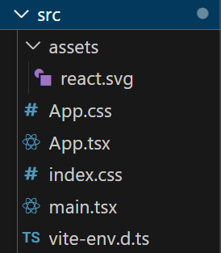
At first, the number of files is overwhelming, but we only use a small number of these to any extent.
Standard files
The files we edit to change our creation are in the src folder so lets focus there

Slide 11
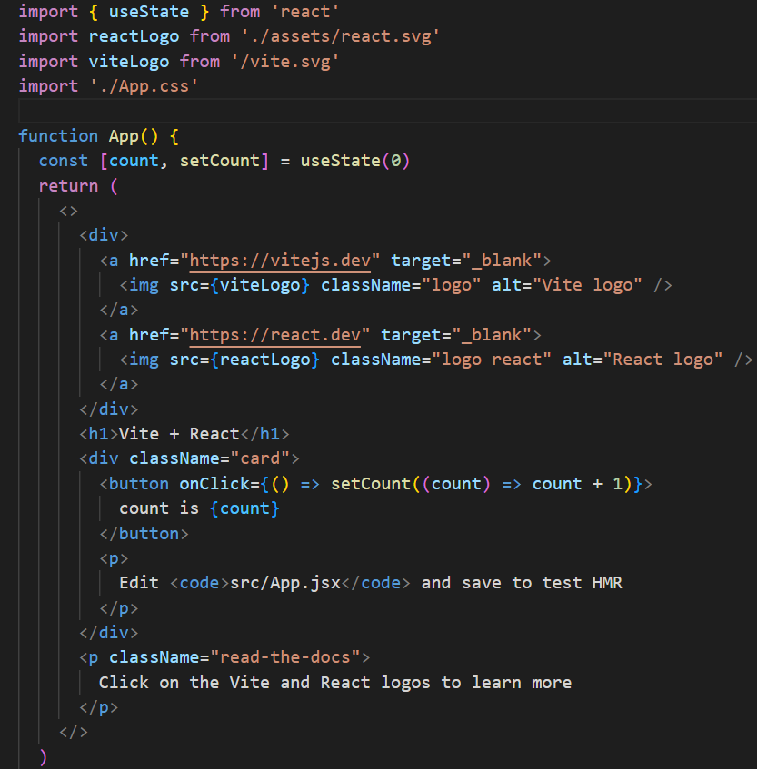
This is the file that is passed to the index.html page in the public folder for rendering.
All of the components we create will eventually be passed here to be displayed on screen
src
App.tsx

Slide 12
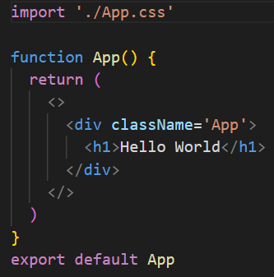
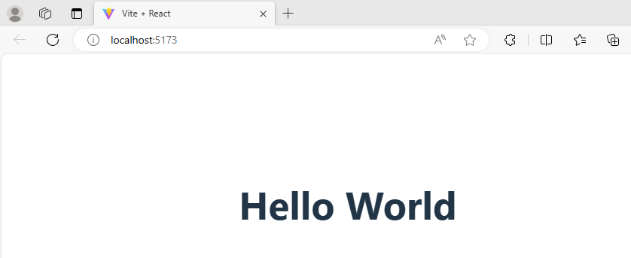
Changing the file to this:
Gives us
src
App.tsx
Notes:
All components feed into the app.js file – more on components later. But they are very important and build up individual elements of any webpage we create

Slide 13
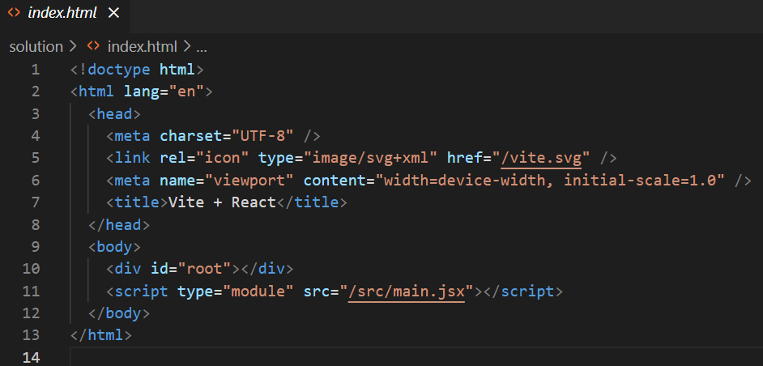
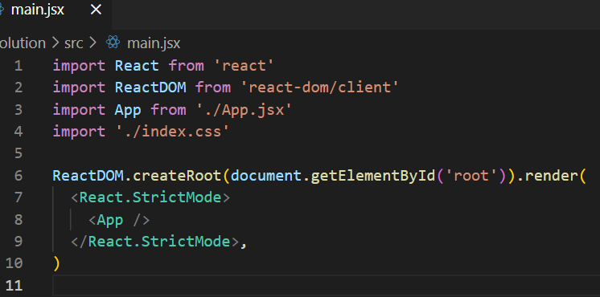
Just like with vanilla JavaScript, you have a webpage which renders the JS in a browser. React is no different .
src
Main.tsx
index.html
Notes:
In the html file is a div with an id of “root”. In the js file is a getElementById constant which finds this and renders the App file into it.
It is a simple as that

Slide 14
Components in react

Slide 15
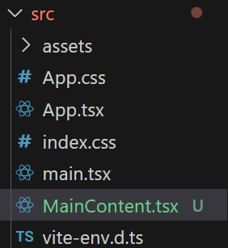
Components are the building blocks of any react application. They are snippets of code that are called into render when required by the SPAs we create.
Generally, it’s a good idea to split the components up and then call them into App.js when required.
The easiest way to learn this is to do it.
Start by creating a new file called MainContent.tsx in your src folder
Overview

Slide 16
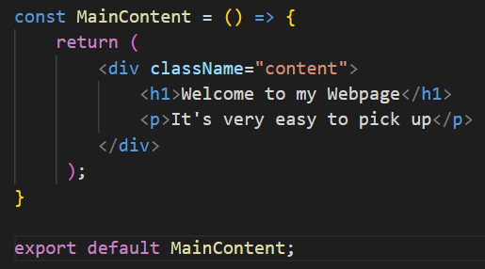
Inside this we need to create a function that returns some TSX.
This is an arrow function that renders when called. The return is what is passed to the index.html page when all components are rendered to main.tsx
Don’t forget to export at the bottom – just like a JS module
Overview
Notes:
JSX is simply a mix of HTML and JavaScript that renders to create content

Slide 17
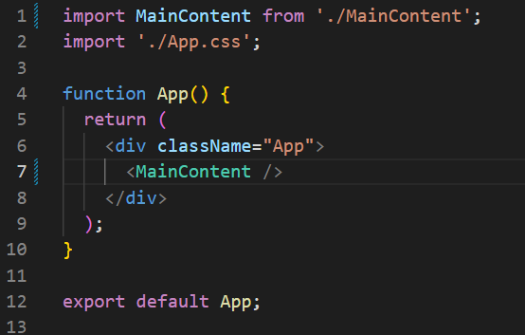
Inside App.js import this module at the top:
Then call the function to be rendered, replacing the <h1> tag
Don’t forget to close the function call!
Overview
Notes:
JSX is simply a mix of HTML and JavaScript that renders to create content

Slide 18
Once you save it, your webpage should re-render to this:
All content in react should be in its own component .tsx file
Overview
Notes:
JSX is simply a mix of HTML and JavaScript that renders to create content

Slide 19
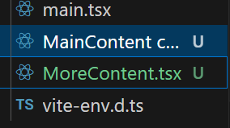
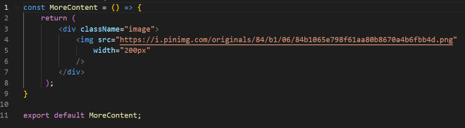
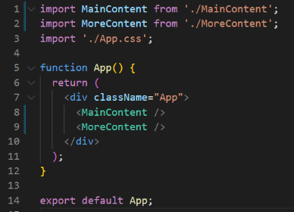
More Components and more imports build our page
Overview
Notes:
JSX is simply a mix of HTML and JavaScript that renders to create content

Slide 20
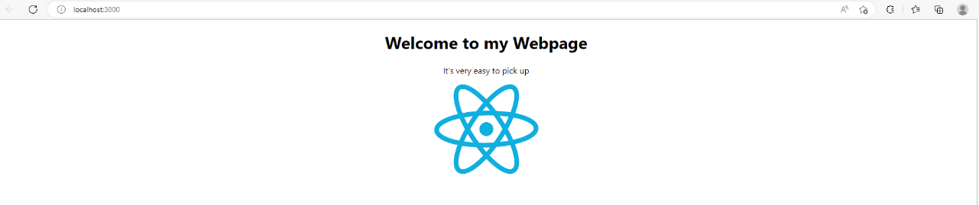
Overview
Notes:
JSX is simply a mix of HTML and JavaScript that renders to create content

Slide 21
Embedding Dynamic content in JSX

Slide 22
One of the major benefits of using react and JavaScript is the ability to have variables and content which are dynamic
You will remember that in JS, we can assign a const or let and then use that value in expressions { } within the code block.
Variables and constants are usually created above the return and then used in the return itself
Expressions

Slide 23
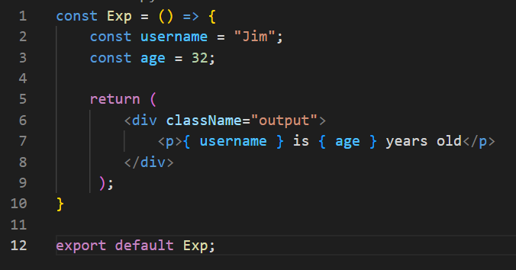
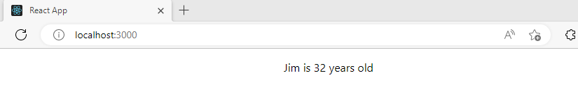
This will render the value of the constant above in the return. It also works with numbers
Expressions

Slide 24
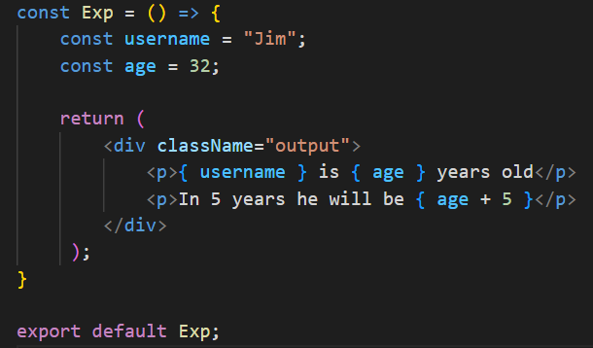
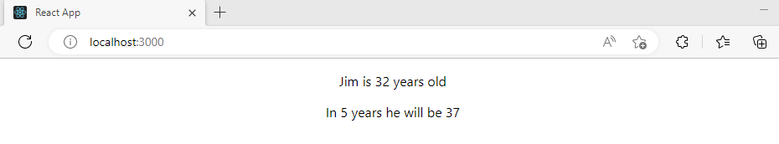
Like other Expressions, you can perform calculations within the curly braces.
Expressions

Slide 25
It is very good practice to create your components as pure. That is they:
Does not change any object or variable that existed before it was called
Given the same inputs, always returns the same result
Following this simple rule will avoid hugely unpredictable bugs and unexpected behaviour as your codebase gets larger and more complex
Easy to make mistakes….
Pure components

Slide 26
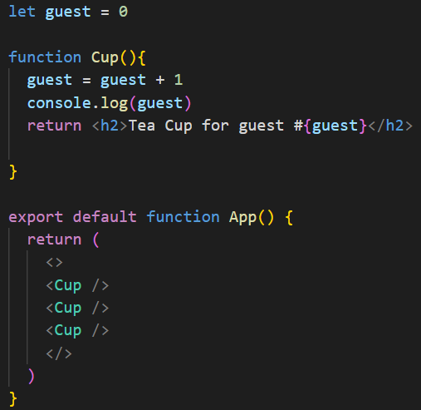
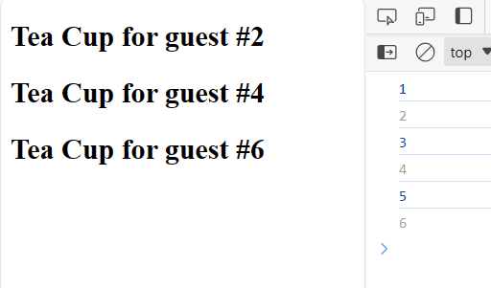
Here is a component that changes the value of an external variable
Pure components
Notes:
The function runs twice because of the initial render and then the hook loading the function. Hence there is unwanted changes to the variables

Slide 27
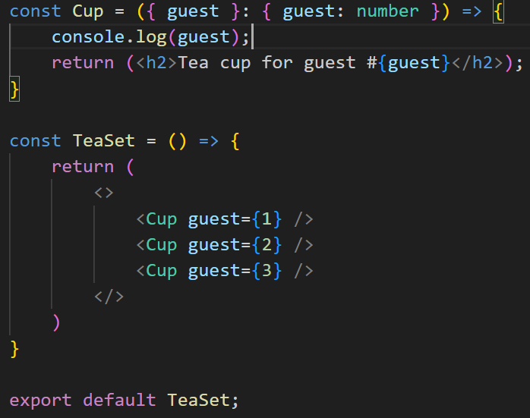
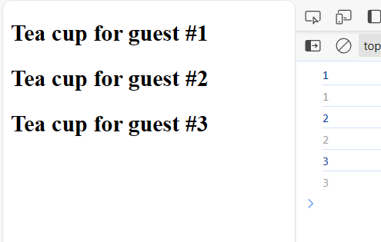
Passing ‘guest’ as a prop fixes this component issue
Pure components
Notes:
The function runs twice because of the initial render and then the hook loading the function. Hence there is unwanted changes to the variables

Slide 28
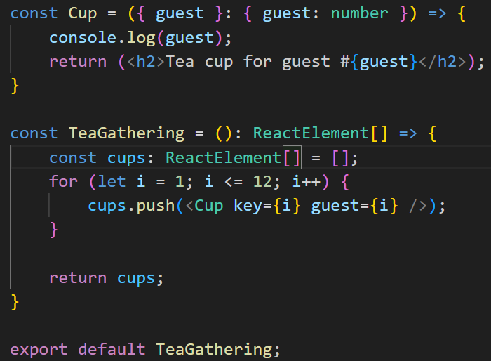
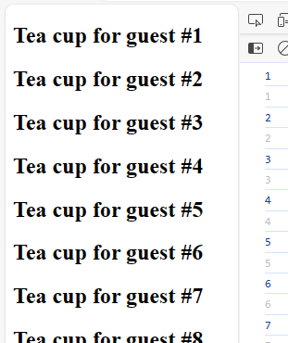
It’s also good practice to change variables and objects that have been especially created while rendering
Pure components
Notes:
The function runs twice because of the initial render and then the hook loading the function. Hence there is unwanted changes to the variables

Slide 29
Props in react

Slide 30
Props are React’s way of passing information to a component.
Like how an <img> tag in HTML can accept attributes like “src” and “width”, React components can accept data in the form of props.
Props are incredibly useful for creating reusable components.
React props

Slide 31
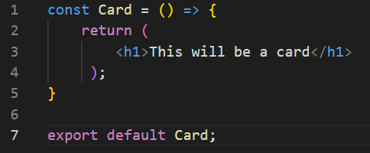
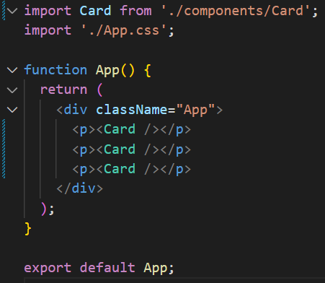
I can create a component which can be reused time and time again
React props

Slide 32
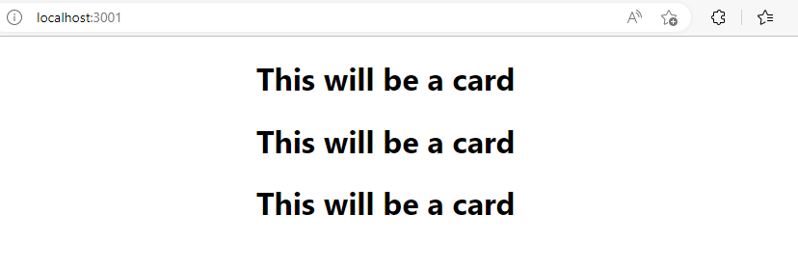
This creates a predictable output
React props

Slide 33
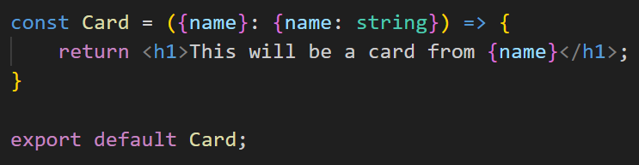
Props allow us to pass data to a child component and then have it used and re rendered based on the content we have given it.
For example, I can add a parameter to the function and then use it in the return, just like JS
This now requires information to be passed with the call. It will be deconstructed like a map
React props

Slide 34
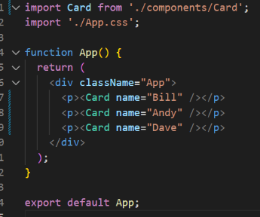
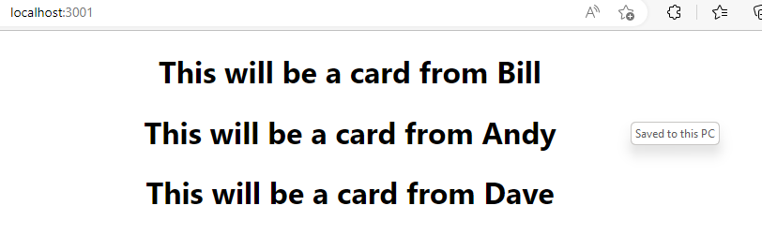
Adding this as Props to the call allow it to be returned and rendered in the App
React props
Notes:
The component is now completely reusable and will simply return the information that was passed in

Slide 35
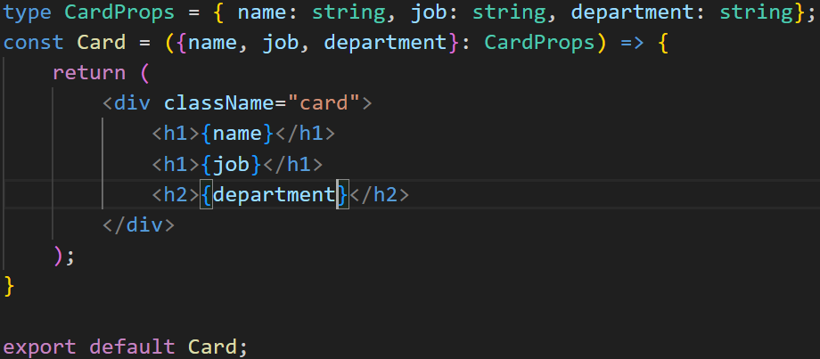
We can now change this content and pass more than one Prop to the component call.
React props
Notes:
The component is now completely reusable and will simply return the information that was passed in

Slide 36
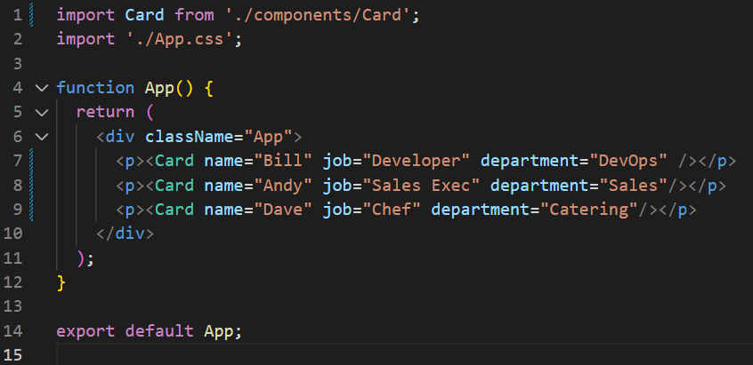
We can now change this content and pass more than one Prop to the component call.
React props
Notes:
The component is now completely reusable and will simply return the information that was passed in

Slide 37
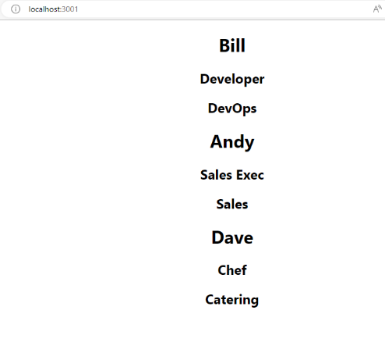
We can now change this content and pass more than one Prop to the component call.
React props
Notes:
The component is now completely reusable and will simply return the information that was passed in

Slide 38
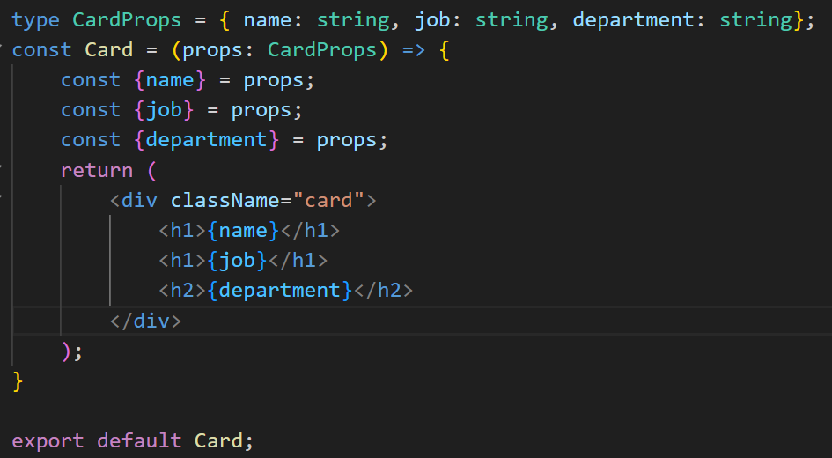
We can also pass the Props in and deconstruct them within the function itself
React props
Notes:
This is how we drag content in with arrays in react and JS. More to come on this later

Slide 39
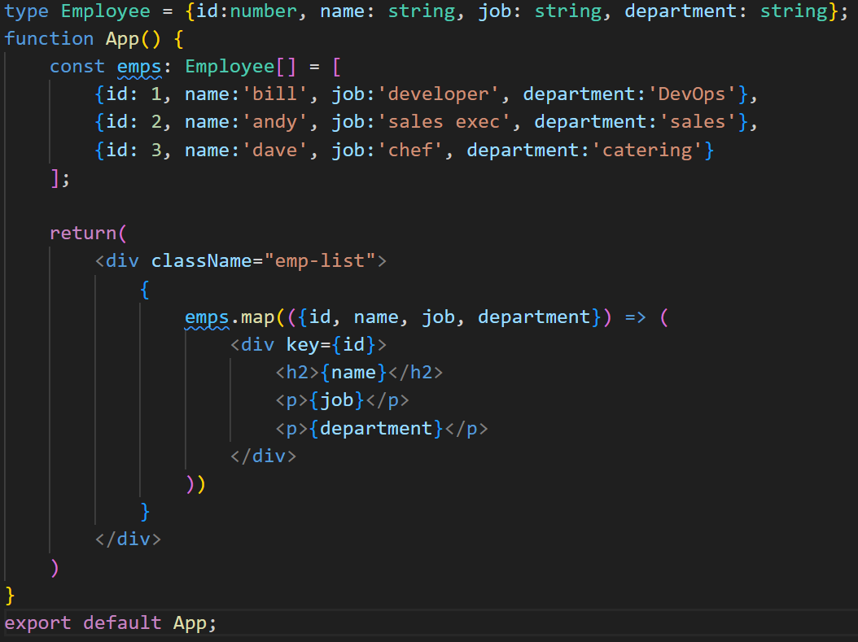
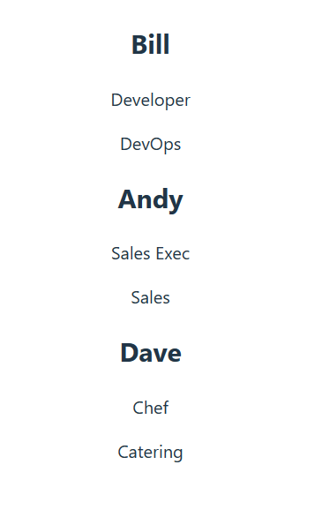
We can also pass variables into children via props, then decompose them separately
React props
Notes:
This is how we drag content in with arrays in react and JS. More to come on this later

Slide 40
As part of best practice, we should remove the functionality to another component. There are many reasons why this is a good idea.
Reusable functionality – there may be more than one occasions where we want to display this data
Separation of concerns – if we need to update this component, replacement and debugging is much less hindered
React props
Notes:
This is how we drag content in with arrays in react and JS. More to come on this later

Slide 41
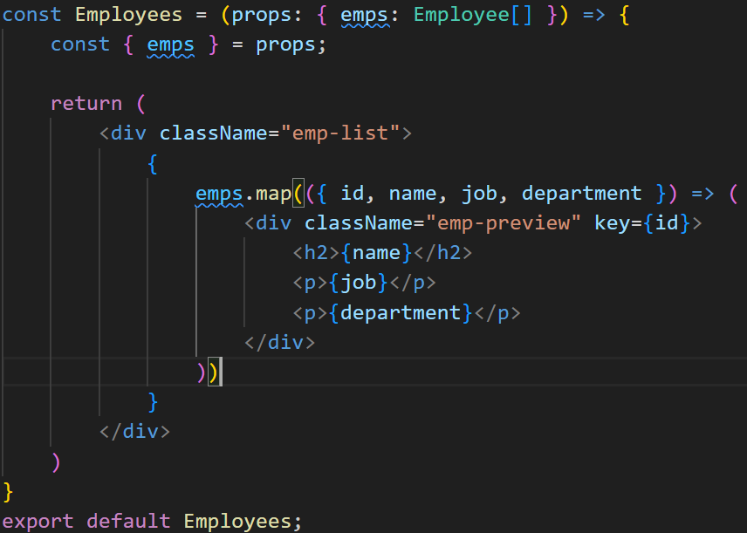
We created a component called Employees.tsx and moved the functionality into it
React props

Slide 42
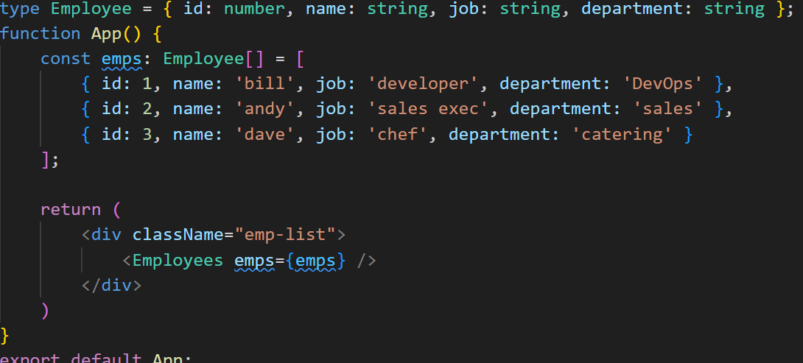
In App.tsx, we simply import the Employees functionality and pass the employees into the call as props
React props
Notes:
This is how we drag content in with arrays in react and JS. More to come on this later

Slide 43
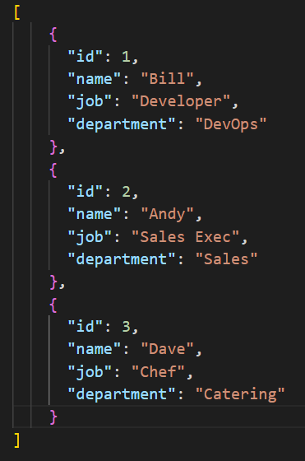
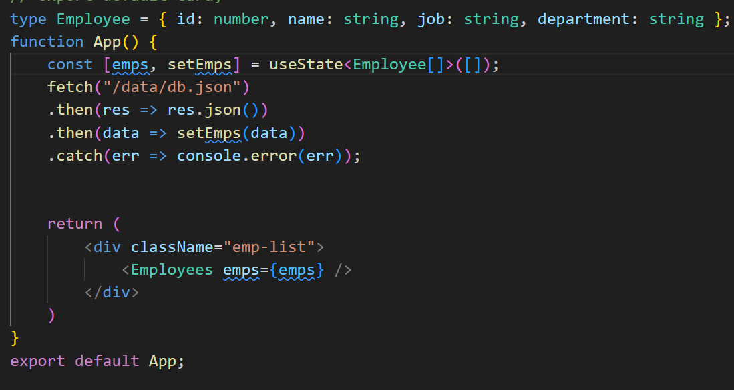
What is more likely however, is dragging content into our webpage from an external source. As a very simple example, We have created a JSON file with the information regarding our employees.
Then we create a variable to hold the data (much more on this later) and pulled it into the component.
React props
Notes:
Nothing else has changed, but this allows us to display the content within the webpage as normal. This is poor coding, and is proof of concept only. State will be investigated to a high level moving forward.

Slide 44
Useful Techniques

Slide 45
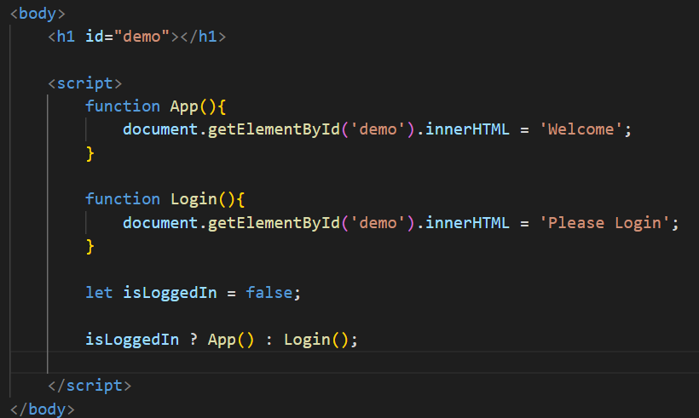
We can truncate an if statement in JS to just one line. Not only can this make the code easier to read, it also underpins one of the most helpful logic patterns we use in React
This code block is simple JS embedded in a webpage
JS Ternary Statements

Slide 46
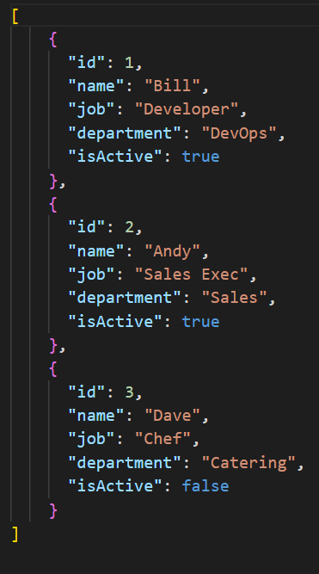
Updating this to React, we can conditionally render not only individual components, but specific component elements.
Previously, we fetched content from a json file. I have added another KV pair to each record.
isActive is a Boolean which can
be used within React to decide
when something should be
rendered onto the webpage
Conditional Rendering

Slide 47

In Employees.tsx, I have added a simple block of code which performs a check.
{isActive && “✓”} is a conditional rendering block.
The && is a Boolean AND.
IF isActive is True, the tick is displayed
Conditional Rendering

Slide 48

When the records are pulled in from the json file. The tick will only be rendered if isActive is True
Conditional Rendering

Slide 49


Form are the primary method of moving data from a React app into persistent storage. The control of the data is something that requires a little more input than vanilla JS
We have to have a variable for each of the input boxes (deep dive on state and hooks to follow)
Forms and Collecting data

Slide 50



The return JSX then builds the form. In React, we constantly update the state when the user put information into the text box. *
Forms and Collecting data
* Be weary of re-rendering on state change

Slide 51

Best practice with forms, validation and data wrangling is to use a library such as React-Hook-Form.
This manages form data and limits re-renders while reducing component mounting overheads
Forms and Collecting data
Notes:
Home | React Hook Form - Simple React forms validation (react-hook-form.com)
Demo at the bottom of the screen – look at re-renders, loading time and live demo at the bottom

Slide 52
Component Lifecycles

Slide 53

In React, components are managed by a lifecycle that allows us control the behaviour of components at different points. The main 3 parts are:
Mounting
Updating
Unmounting
Methods are called:
Constructor where state is initialized and event handlers are binded
When the state of the component changes the render method is called again
When a component is being removed from the DOM, the componentWillUnmount method is called
Render method –puts the UI into the DOM
You can perform additional side effects via the componentDidMount method, just as before
This is where any clean up is performed, such as API cancelling or unsubscribing from events
ComponentDidMount – responsible for Re-rendering
These have been replaced by the useEffect hook
Notes:
It is somewhat more complex than this, with the addition of getDerivedStateFromProps() in the mounting phase. The getDerivedStateFromProps() method is called right before rendering the element(s) in the DOM.
This is the natural place to set the state object based on the initial props.
It takes state as an argument, and returns an object with changes to the state.
Also, in the Updating stage, it can be broken down further
getDerivedStateFromProps()
shouldComponentUpdate()
render()
getSnapshotBeforeUpdate()
componentDidUpdate()
shouldComponentUpdate
In the shouldComponentUpdate() method you can return a Boolean value that specifies whether React should continue with the rendering or not.
The default value is true.
In the getSnapshotBeforeUpdate() method you have access to the props and state before the update, meaning that even after the update, you can check what the values were before the update.
If the getSnapshotBeforeUpdate() method is present, you should also include the componentDidUpdate() method, otherwise you will get an error.

Slide 54
Merge of componentDidMount and componentDidUpdate
useEffect(() => { console.log(“This is mounted or updated.”); });
Equivalent of componentDidMount
useEffect(() => { console.log(“This is mounted only not updated.”); }, []);
useEffect

Slide 55
useEffect
Merge of componentDidMount and componentDidUpdate but only for given dependency
useEffect(() => {
console.log(“This is mounted or count state updated.”);
}, [count]);

Slide 56
Component Hierarchies

Slide 57
There are several schools of thought of how best to lay out components. Throughout the course, there will be several examples of how we can lay out pages and components.
The examples and projects we complete will have different methods.
Setting out components

Slide 58

In this example, an estate agent site we will look at later, The components are split up into blocks of functionality.
The JS components for that section and the relevant CSS all exist in their isolated folders.
This is excellent for creating microservices that can be maintained and updated independently
Setting out components

Slide 59



In this example, a simple shop with a cart (state management with context), you can see the pages and components have been split up. Again, with the CSS in the relevant folder
Notice the navbar is a component that is called into App.js and the content is changed with routes
Setting out components

Slide 60

As these become more complex and more complete, different languages and frameworks are needed to further isolate the roles and features
Here, you can see the web front
end, built in React, and the
middleware / back end built
with Java and springboot
Setting out components

Slide 61
Labs and Activities

Slide 62
The standard exercise for react is to build a ToDo list. This will be a rolling theme but will form the basis of higher levels of best practice moving forward.
Throughout the week, there will be new challenges, but let’s start here
Demo of Simple blog technology on a single page
Simple Single page – No routing yet!

Slide 63
Challenge
Create a single (non routed) page that has a form within it.
Build a JSON Server for testing the concept of sending and receiving data which is refreshed when new content is added.

